Slide 1
Just in Time Access Management App
Enabling secure and efficient temporary production access for developers
Present by: Henry Tran

Slide 2
Table of Contents
01
02
03
04
Problem statement
Highlights the need for temporary, secure production access.
Solution Overview
Just in Time Access Management.
Features
Features
Plan
Investment overview, including expected savings and ROI

Slide 3
01
Problem Statement

Slide 4
The Challenges
Development Constraints
Production Access Requirements
Security Risks
Developers are restricted to the dev environments
Temporary access is needed for bug resolution
Poor access control risks misuse, breaches, and non-compliance

Slide 5
02
Solution Overview

Slide 6




The solution: JAM
1
Just-in-time Access Management
2
Automated Workflow
3
Time-bound Access
4
Logging and monitoring

Slide 7
User Workflow
Request
Developer submits access request
Provision
System automatically grants access
1
2
3
4
Approval
Superior reviews and approves/denies
Revocation
Automatic termination of access

Slide 8
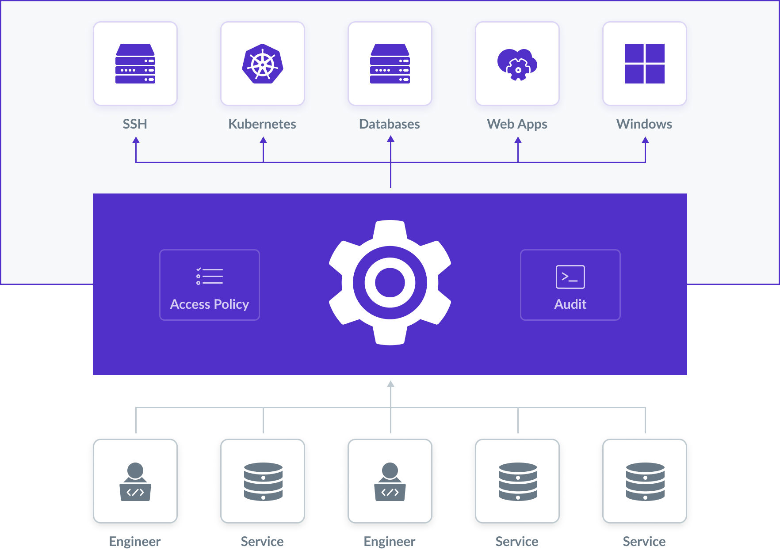
Example
Open source: Teleport

Slide 9
03
Features

Slide 10
Features
01
02
03
04
Request management
Developer can submit access requests environment and duration
Approval Workflow
Requests are routed to designed superiors for approval
Automated Access
Automatically provisioned and revoked after specified time
Audit logging
Comprehensive logs of all access requests and approvals

Slide 11
04
Plan

Slide 12
Plan
Phase 1: Research & Validation (4 weeks)
Conduct surveys and define core requirements
Phase 2: MVP Development (10 weeks)
Build and test a prototype with essential features
Phase 3: Beta Testing (4 weeks)
Roll out to a small group users for feedback
Phase 4: Full Launch
Release the product

Slide 13
Thanks!
Do you have any questions?
hungtm@nobisoft.com.vn
nobisoft.com.vn

